Slide 1
MODULE NAME: EMBEDDED SYSTEM DEVELOPMENT
MODULE CODE: ITLES801
RQF LEVEL: 8
NUMBER OF CREDITS: 10
DEPARTMENT: ICT
PROGRAM: INFORMATION TECHNOLOGY
LEARNING HOURS: 100
Module Leader:Mrs.Eng. YANKURIJE Madeleine

Slide 2
Purpose Statement
This module describes the skills, Knowledge and attitude required to develop an embedded system.
At the end of this module, the trainee will be able to :
Design embedded system architecture
Develop hardware device
Develop embedded firmware, and
Manage embedded system.

Slide 3
LEARNING OUTCOMES
Design Embedded System Architecture
Develop hardware device
Develop Embedded Software (Firmware)
Manage Embedded System

Slide 4

LEARNING OUTCOME 1: DESIGN EMBEDDED SYSTEM ARCHITECTURE
Designing embedded system architecture involves creating a structured framework for embedded systems, which are the specialized computing systems dedicated to specific tasks or functions within larger systems.

Slide 5
Conts
This process includes defining the:
System's components
Interfaces, and data processing capabilities to meet specific requirements such as performance, power consumption, and reliability.
Embedded system architects need to consider various factors, such as hardware and software integration, real-time processing, and communication protocols, to design efficient and reliable systems.

Slide 6

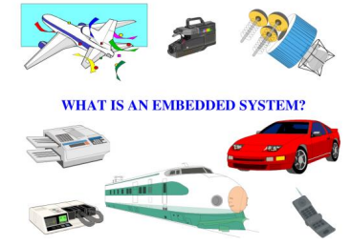
1.1. INTRODUCTION TO EMBEDDED SYSTEM

Slide 7
CONTS
Actually Let know first What system means? What Embedded means?
System is a set of interrelated parts/components which are designed/developed to perform common tasks or to do some specific work for which it has been created.
Embedded means including something with anything for a reason. Or simply we can say something which is integrated or attached to another thing.
So, Embedded System is an integrated system that is formed as a combination of computer hardware and software for a specific function.

Slide 8
OR
It can be said as a dedicated computer system that has been developed for some particular reason. But it is not our traditional computer system or general-purpose computers, these are the Embedded systems that may work independently or attached to a larger system to work on a few specific functions. These embedded systems can work without human intervention or with little human intervention.
OR
It is an Electronic/Electro mechanical system which is designed to perform a specific function and is a combination of both hardware and firmware (Software) E.g. Electronic Toys, Mobile Handsets, Washing Machines, Air Conditioners, etc.

Slide 9
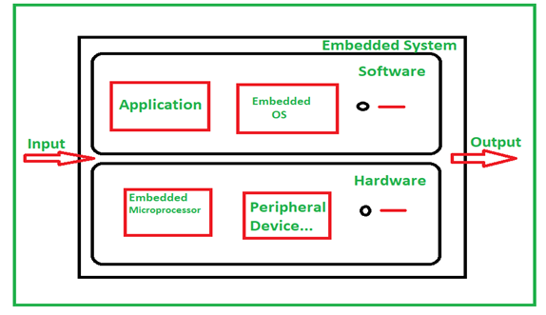
Parts/Components of Embedded System

Slide 10
Conts,
Typical embedded system mainly has two parts i.e., embedded hardware and embedded software. Embedded hardware’s are based around microprocessors and microcontrollers, also include memory, bus, Input/Output, Controller, whereas embedded software includes embedded operating systems, different applications and device drivers.

Slide 11
Some examples of embedded systems
Digital watches
Washing Machine
Televisions
Digital phones
Laser Printer
Cameras
Industrial machines
Electronic Calculators
Automobiles
Medical Equipment

Slide 12
TYPES OF EMBEDDED SYSTEMS
Specifically, an embedded system can be classified based on its performance and functional requirements or the performance of its microcontroller.
So, for the task of care, we will cover both of these classifications below:

Slide 13
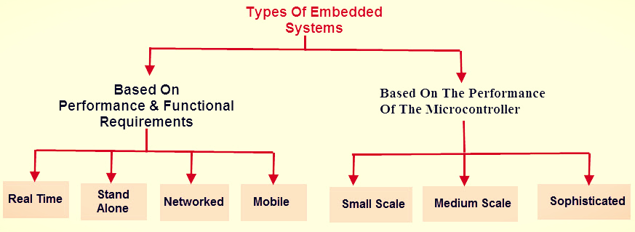

Slide 14
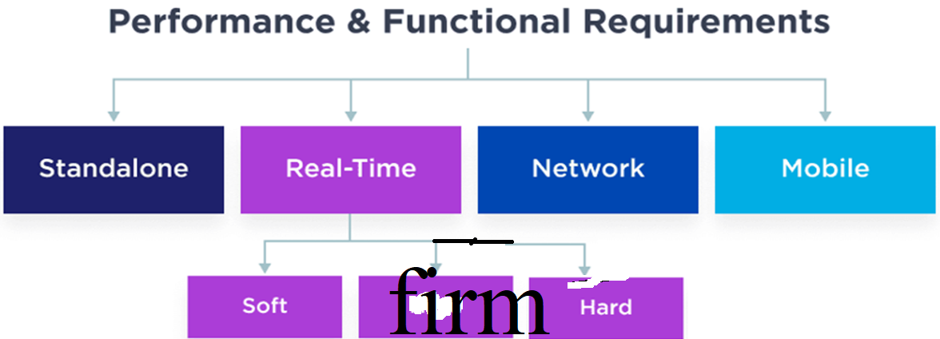
A. BASED ON PERFOMANCE AND FUNCTION REQUIREMENTS

Slide 15
1.Standalone Embedded systems:
A standalone embedded system works by itself.
It is a self-contained device which does not require any host system like a computer.
It takes either digital or analog inputs from its input ports, calibrates, converts, and processes the data, and outputs the resulting data to its attached output device, which either displays data or controls and drives the attached devices, they can produce outputs independently.
Eg: Temperature measurement systems, Video game consoles, MP3 players, digital cameras, Calculators and microwave ovens are the examples for this category. They work by themselves, without relying on a larger platform

Slide 16
2. Real time embedded systems:
An embedded system which gives the required output in a specified time or which strictly follows the time deadlines for completion of a task is known as a Real time system. i.e. a Real Time system, in addition to functional correctness/accuracy, also satisfies the time constraints/limits.

Slide 17
There are three types of Real time systems:
Soft real time system and
Hard real time system
Firm real time system

Slide 18
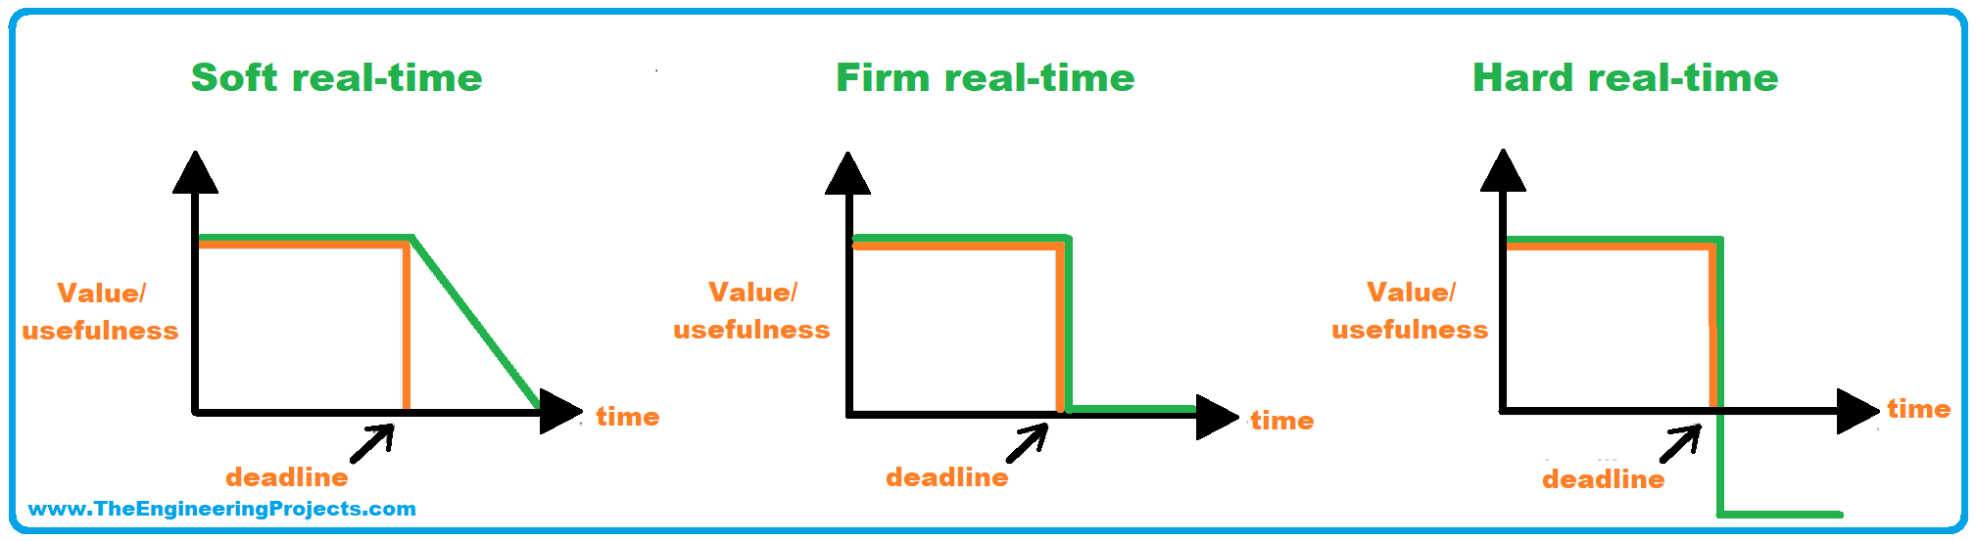

Slide 19
SOFT REAL TIME SYSTEM
When a soft real-time system misses a deadline for a given operation, the operation does not immediately lose all of its value. Instead, the value diminishes over time i.e. it decreases toward zero as time moves farther beyond the deadline. that,
A Real time system in which the violation of time limitations will cause only degraded quality, but the system can continue to operate is known as a Soft real time system.
Examples: A Microwave Oven, washing machine, TV remote, websites, computer games, cellular networks, online database and multimedia transmission and reception. etc

Slide 20
b)HARD REAL TIME SYSTEM
A Real time system in which the violation of time constraints will cause critical failure and loss of life or property damage or catastrophe is known as a Hard Real time system. These systems usually interact directly with physical hardware instead of through a human being.
The output must be completely on time, the prescribed deadline cannot be missed in any case. You can't submit your exam paper after the time is over.
Ex: Deadline in a missile control embedded system, Delayed alarm during a Gas leakage, car airbag control system, A delayed response in pacemakers, Failure in RADAR functioning etc.

Slide 21
c)FIRM REAL TIME EMBEDDED SYSTEMS
Timelines of a task are crucial but the missed deadline can be compensated as it occurs rarely. Missed deadline doesn't degrade the system performance. In case of the missed deadline, the system continues to perform and discard the delayed response.
Ex: financial forecast, etc

Slide 22
3. Networked embedded systems
The networked embedded systems are related to a network with network interfaces to access the resources. The connected network can be a Local Area Network (LAN) or a Wide Area Network (WAN), or the Internet. The connection can be either wired or wireless.
The networked embedded system is the fastest growing area in embedded systems applications. The embedded web server is such a system where all embedded devices are connected to a web server and can be accessed and controlled by any web browser for output generation.
Eg: Home and office security systems, Automated teller machines (ATMs), Point of sale (POS) systems…

Slide 23
4.Mobile Embedded systems
Mobile embedded systems refer specifically to small, portable embedded devices like cellphones, laptops, calculators, digital cameras, MP3 players, PDA (Personal Digital Assistants) are the example for mobile embedded systems.
The basic limitation of these devices is the limitation of memory and other resources

Slide 24
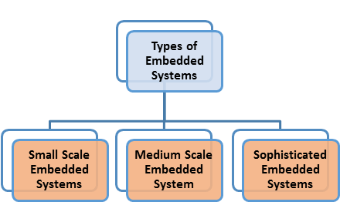
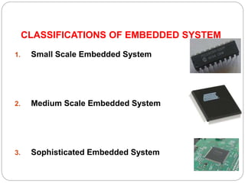
B.TYPES OF EMBEDDED SYSTEM-BASED PERFORMANCE OF MICROCONTROLLER

Slide 25
1.SMALL SCALE EMBEDDED SYSTEMS
This embedded system can be designed with a single 8 or 16-bit microcontroller. It can be operated with the help of a battery.
As the name suggests a small-scale embedded system makes use of a small sized microcontroller, ranging from 8 bit to 16 bit.
They are less complex in terms of hardware and software and can be operated with batteries as well because of their smaller size. Mostly the C programing language is used in such embedded systems.
Example: Wearable device(smartwatches, and health monitors equipped with sensors and microcontrollers to track activities, monitor health parameters, and provide notifications) , Sensors,…..

Slide 26

2.MEDIUM SCALE EMBEDDED SYSTEMS
These types of embedded systems are designed using 16 or 32-bit microcontrollers. These systems offer both hardware and software complexities. C, C++, Java, and source code engineering tool, etc. are used to develop this kind of embedded system.
Example: ATM, which is widely used by us nowadays has a medium-scale embedded system in it

Slide 27
3.SOPHISTICATED EMBEDDED SYSTEMS
These types of embedded systems are designed using 32 or 64-bit microcontrollers. This type of embedded systems has lots of hardware and software complexities
These systems are designed for performing complex tasks and functions.
Example:Modern-day air conditioners; Medical imaging systems ….

Slide 28
Application areas of embedded system
Home appliances
Transportation
Health care
Business sector & offices
Defense sector
Agricultural Sector
Computer Peripherals
Computer Networking Systems
Measurement & Instrumentation

Slide 29
CHARACTERISTICS OF AN EMBEDDED SYSTEM
Performs specific task
Low Cost
Time Specific
Low Power
High Efficiency
Minimal User interface
Less Human intervention
Highly Stable
High Reliability
Use microprocessors or microcontrollers
Etc

Slide 30
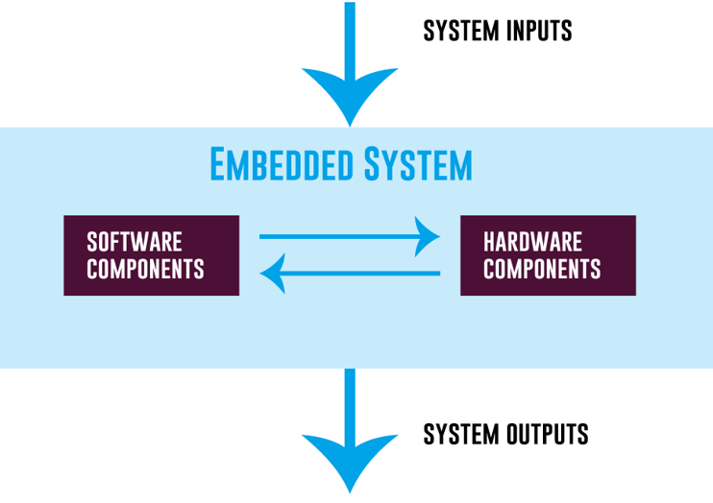
Block Structure Diagram of Embedded System

Slide 31
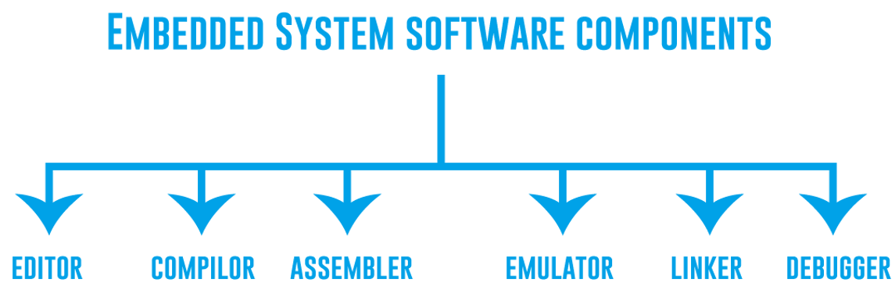

Slide 32
1.Editor
The editor is the first tool you required for embedded system software.
The code you write in C and C++ programming languages will be saved in a text file in the editor
2.Compiler
The code is written in a text editor. But how does a machine understand this code?
A compiler is used to turn this written code into low-level machine language that the machine can comprehend.
3.Assembler
The assembler tool converts the written code into a machine language. It is slightly different than a compiler.
The compiler directly converts the written code into machine language while the assembler, on the other hand, first converts source code to object code and then to the language that the machine can understand.

Slide 33
CONTS
4. Emulator
The main task of the emulator is to make the embedded system act like a real system in a simulation environment
With an emulator, you can run one operating system into another device.
5.Linker
Typically, software code is written in small modules and pieces.
A linker, also called a link editor, is a tool that takes one or more object files and combines them to develop a single executable code.
6. A debugger is a tool used for testing and debugging purposes. It scans the code thoroughly and removes the errors and bugs, and identifies the places where they occur. Programmers can quickly address the errors and fix them

Slide 34
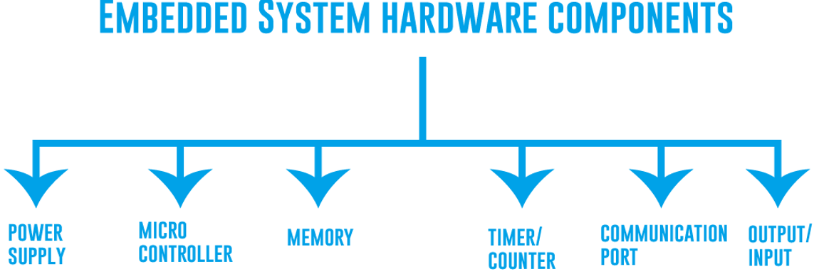

Slide 35
EXPLANATION FROM ONE BY ONE
1. Power Supply
A power supply is a crucial component of the embedded system design.
It is an electrical device mainly used to power up the electrical load.
Normally, a 5V power supply is required for the system, however, it can also range from 1.8 to 3.3V.
2. Microcontroller
An embedded system is either a microcontroller-based or microprocessor-based system. They give a system computing power and are called integrated circuits.
The embedded hardware performance is mainly dependent on the processor which is normally called the brain of the embedded system.
3.ROM/RAM
Memory is essential to store important information in the embedded computer system.
Memory is integrated into a microcontroller or microprocessor.

Slide 36
4. Timers / Counters: Sometimes you need to create a delay before a specific function, Timers are used in such cases. While at times you want to count the number of times a particular event occurs. Counters are used in such cases.
5. Communication Ports :Communication ports are used in embedded systems to establish communication with other embedded systems. There are several communication ports including USB, UART, I2C,etc.
For simple applications, communications ports are utilized from the microcontroller, and for complex and advanced applications these ports are externally installed inside the embedded systems.
6. Output and Input: In the microcontroller, there are a fixed number of input and output ports that you can utilize as per your requirement to provide interaction with an embedded system. For example A sensor can be used to provide input to the system

Slide 37
Advantages of Embedded System
Small size
Enhanced real-time performance.
Easily customizable for a specific application
Specific Functionality
Low Cost
Low Power Consumption
Real-Time Operation
Reliability

Slide 38
Disadvantages of Embedded System
Time-consuming design process.
Limited Flexibility
Complex Development
Scalability Issues
Hardware Limitations
Security Concerns

Slide 39
DIFFERENCE BETWEEN COMPUTER AND EMBEDDED SYSTEM
Category | Computer | Embedded device
Description | A computer is a combination of hardware and software resources which are integrated together and provides various functionalities to the user. | An embedded device is a part of an integrated system that is formed as a combination of computer hardware and software for a specific function and which can operate without human interaction.
Human Interaction | A computer needs Human Interaction to perform tasks. | Embedded device does not need Human Interaction to perform tasks or a small.
Alterable | Here applications are alterable(programmable)by the user(it is possible for end user to re-install the OS and add or remove user application. | The firmware of embedded system is pre-programmed and it is non-alterable by the end user.

Slide 40
Conts,
Parts | It has 2 parts: Hardware and Software. | It has 3 parts: Hardware, Firmware and Software.
Tasks | It can perform many tasks. | It performs limited tasks.
Cost to user | The user has to pay more for a computer. | The user incurs/suffers lesser cost for an embedded system.
Peripherals | Computers have peripherals such as keyboard and mouse, display, printer, Hard disk drives, floppy disk drives, optical disc drives etc. | Embedded Devices have peripherals such as Serial Communication Interfaces (SCI), Synchronous Serial Communication Interface, Universal Serial Bus (USB), Multi Media Cards (SD cards, Compact Flash) etc.
Purpose | Computers can be reprogrammed to for a new purpose. | Embedded Devices are made only for a specific set of purposes.
Power Consumption | Computer needs more operational power than Embedded Devices. | Embedded Device needs lesser operational power than a computer.

Slide 41
Conts,..
Complexity | Computers are more complex devices than Embedded Devices. | Embedded Devices are less complex devices than Computers.
Response Time | Response requirements are not time critical. | For certain category of embedded systems the mission critical systems ,the response time requirement is highly critical.
Usage Difficulty | Computers are more Difficult when used, compared to an Embedded System. | Embedded are easier to use than Computers.

Slide 42
Conts,..
User Interfaces | It requires more user interface than Embedded Devices. | It requires lesser to no user interface than Computers.
Time Specificity | Computers are not time specific. They may need to perform tasks which are not time bound and take days to perform as well. | Embedded Devices are time specific. The tasks assigned to them need to be performed within a specific time frame.
Size | Computers are usually bigger in size with larger hardware and input output devices attached to it. | Embedded Devices are smaller in size than Computers, with limited hardware.
Developed in | 1833 A.D. with Charles Babbage as developer | 1965 A.D. by developer Charles Stark Draper
Memory Requirement | Computers have larger memory requirement due to a lot of storage of data. | Embedded Devices need lesser Memory.

Slide 43
1.2. Gathering system requirements
Clearly, before we design a system, we must know what we are designing.
First, we gather an informal description from the customers known as requirements, and we refine the requirements into a specification that contains enough information to begin designing the system architecture.
Requirements may be functional or nonfunctional

Slide 44
a. Functional requirements
Functional requirements specify what the system should do. And they include:
Functionality: These requirements specify what the system should do, defining its intended behavior and operations.
Use Cases: Understanding various scenarios and interactions with the system. Use cases outline specific actions, inputs, and expected outputs.
Interfaces: Specifications of interactions between different system components or external systems. This could involve communication protocols, data formats, and interaction sequences.

Slide 45
b. Non-functional requirements
Non-functional requirements specify constraints, qualities, or characteristics that describe how the system should behave or operate. They include:
Performance: The speed of the system is often a major consideration both for the usability of the system and for its ultimate/final cost.
Cost: The target cost or purchase price for the system is almost always a consideration.
Physical size and weight: The physical aspects of the final system can vary greatly depending upon the application.
Power consumption: Power, of course, is important in battery-powered systems and is often important in other applications as well.

Slide 46
Conts,…
Name: This is simple but helpful. Giving a name to the project not only simplifies talking about it to other people.
Purpose: This should be a brief one- or two-line description of what the system is supposed to do.
Inputs and outputs: Analog electronic signals? Digital data? Mechanical inputs? , Periodically arriving data, such as digital audio samples, How many bits per data element?
Functions: This is a more detailed description of what the system does.

Slide 47
c.Create system block diagram
A system block diagram is a graphical representation of a system that shows the interconnected components and how they interact with each other.
In gathering embedded system requirements, a system block diagram can be useful in identifying the different system components and their relationships.
Here below there is a sample block diagram:

Slide 48
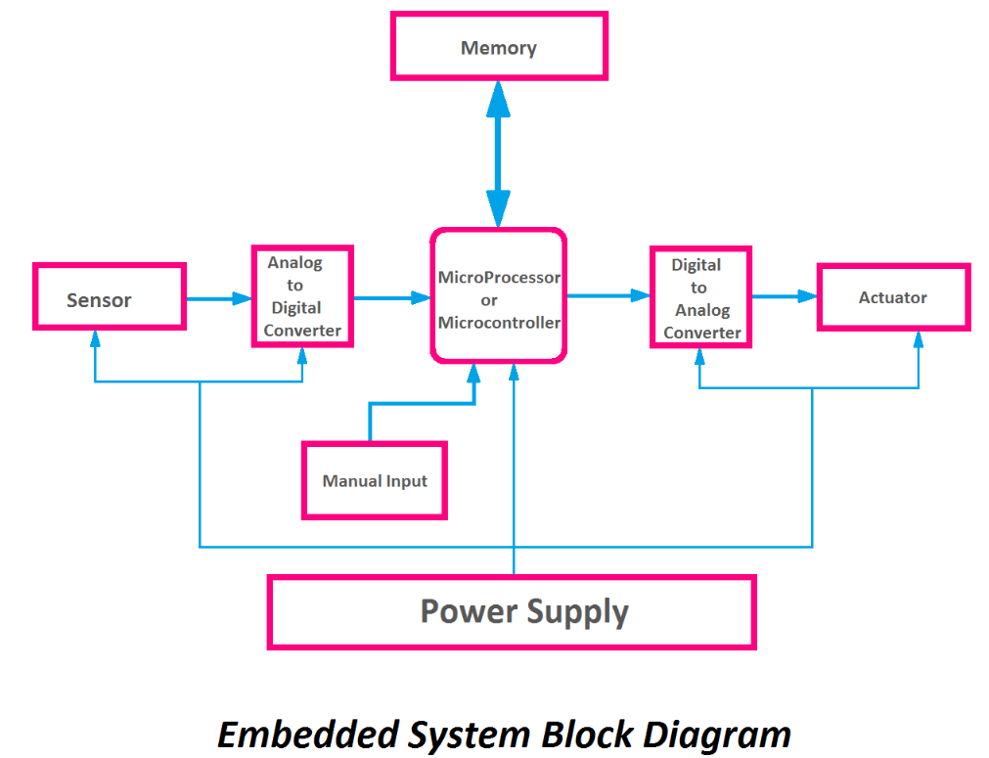

Slide 49
1.3. Identification of hardware components
WORK 1:(Presentation)
Question: Use your group work to discuss in deep about:
Identification of the following hardware components that are needed in embedded system design:
Microcontroller
Memory
Input/Output (I/O) Ports
Sensors
Electronic and electromechanical components
Power Supply
Communication Interfaces (UART, SPI, I2C, Wi-Fi, Bluetooth and RF)

Slide 50
1.4. Production of Circuit Diagram of Embedded System
WORK2:
Download the following Online Tools software used in designing circuit diagram of embedded:
1.EasyEDA
2.Fritzing

Slide 51
1.4.Production of Circuit Diagram of Embedded System
The "Production of Circuit Diagram of Embedded System" refers to the process of creating a visual representation or schematic diagram that illustrates the electrical connections and components of an embedded system.
This process involves designing and drafting a detailed diagram that show cases how various electronic components, such as microcontrollers, sensors, actuators, power sources, and interfaces, are interconnected within the embedded system.
Let us start by looking some useful circuit design software preferred for this task:

Slide 52
Identification of Circuit Designing Software
To create a circuit diagram for an embedded system, you first need to choose appropriate circuit design software.
There are both online and offline options available, each with its own features and capabilities.
a.Online Tools:
1.EasyEDA
2.Fritzing
3. CircuitLab

Slide 53
EasyEDA
EasyEDA is currently available in two editions:
EasyEDA Professional and EasyEDA Standard.
The Standard Edition is geared towards students and education, with simpler features and usage;
The Professional Edition is geared towards enterprises and teams, with more powerful features and higher constraints.

Slide 54
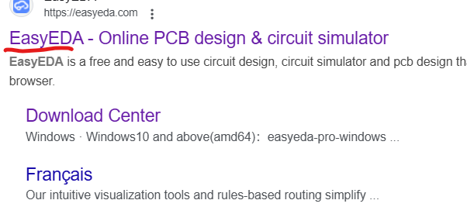
To open easyEDA
1. open google.com
Write in search engine easyEDA
Select
2.Or write website in address bar: https ://easyeda.com/

Slide 55
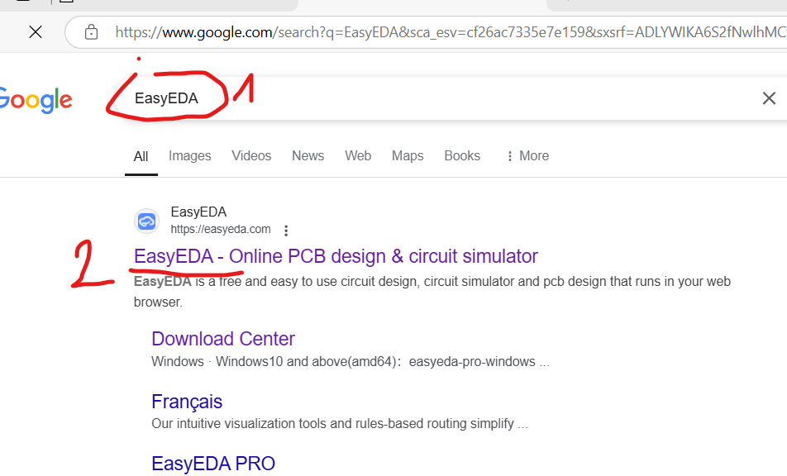

Slide 56
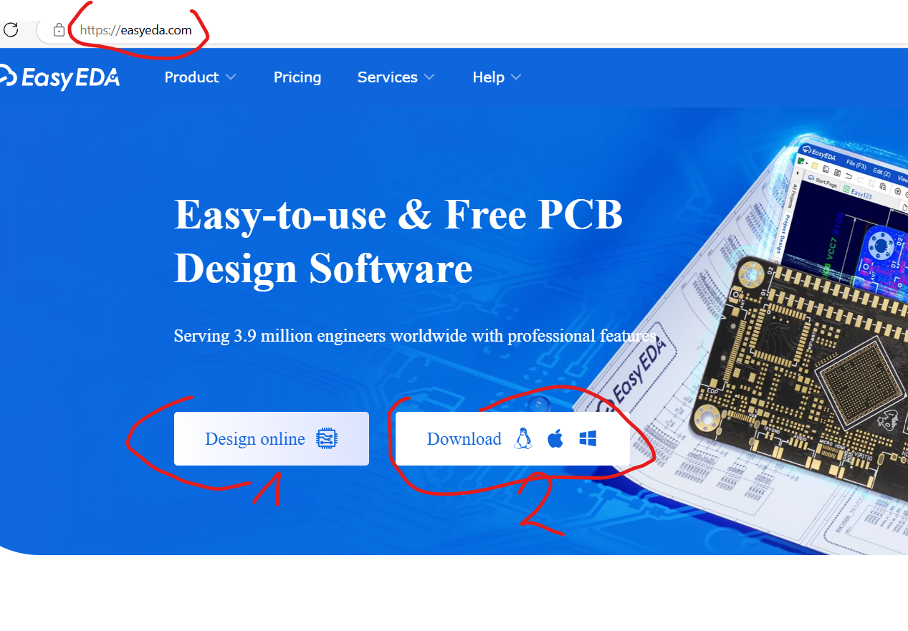
You get/see two buttons: Design online and Download
you can select download and you will use it next time
You can select design online

Slide 57
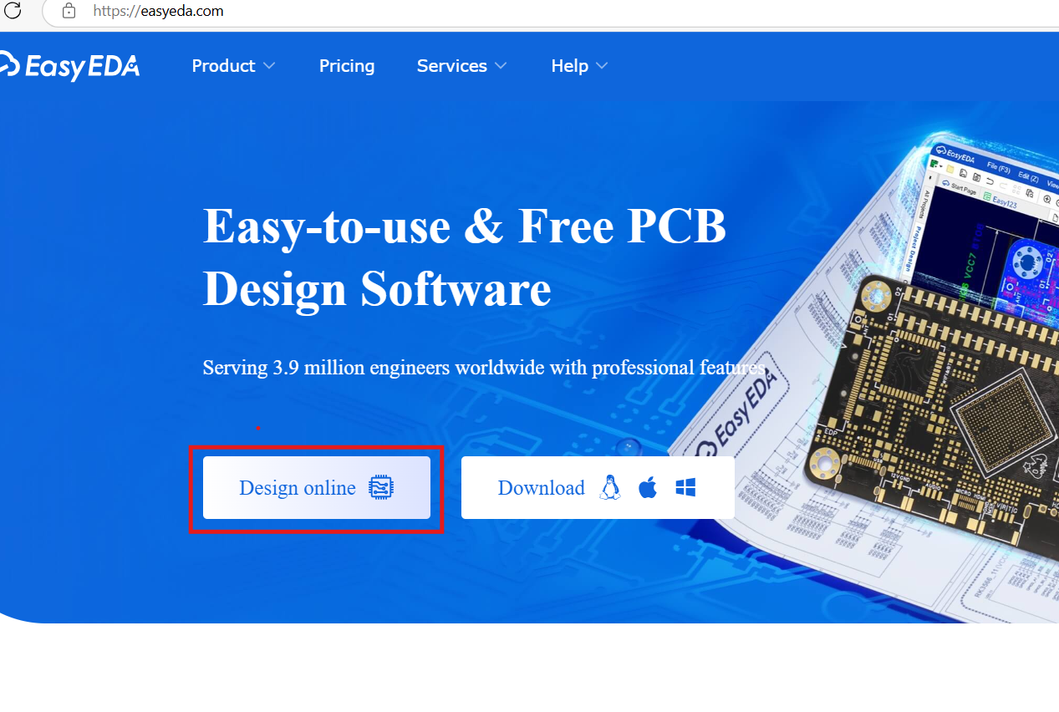
Use "Design Online" if:
You want to start designing quickly and easily.
You prefer working online and don't want to download any software.
You have a stable internet connection.

Slide 58
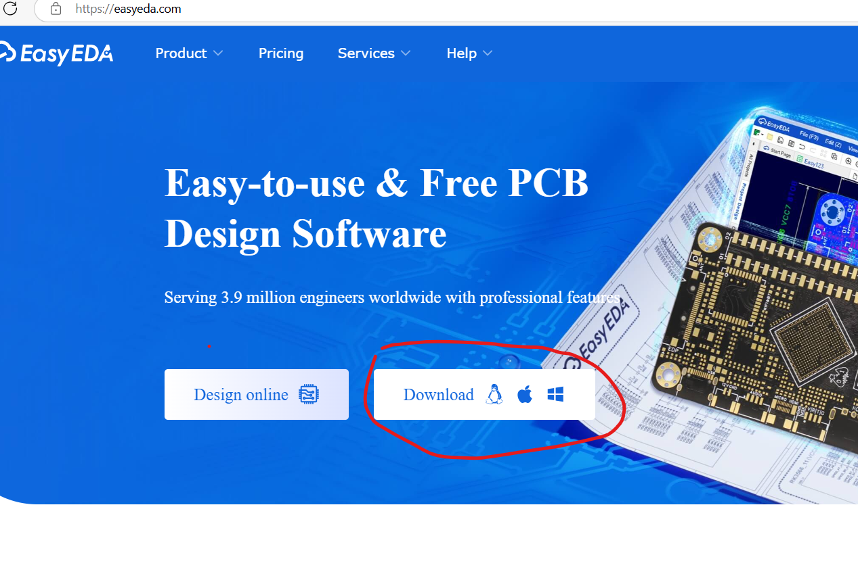
Use "Download" if:
You prefer to see it offline as icon on the desktop.
You need access to advanced features that might be available in the online version after clicking on it.
You have concerns about internet connectivity or speed.

Slide 59
For students, the "Design Online" button is generally more important and convenient for the following reasons:
Accessibility: Online access is crucial for students who may not have administrative privileges to install software on school computers or who are working from home.
Ease of Use: The online version is often streamlined/ efficient and easier to navigate, making it more approachable for beginners.
Collaboration: Online platforms often facilitate collaboration features, allowing students to work together on projects remotely.
Free Access: EasyEDA offers a free online version, making it a cost-effective solution for students.

Slide 60
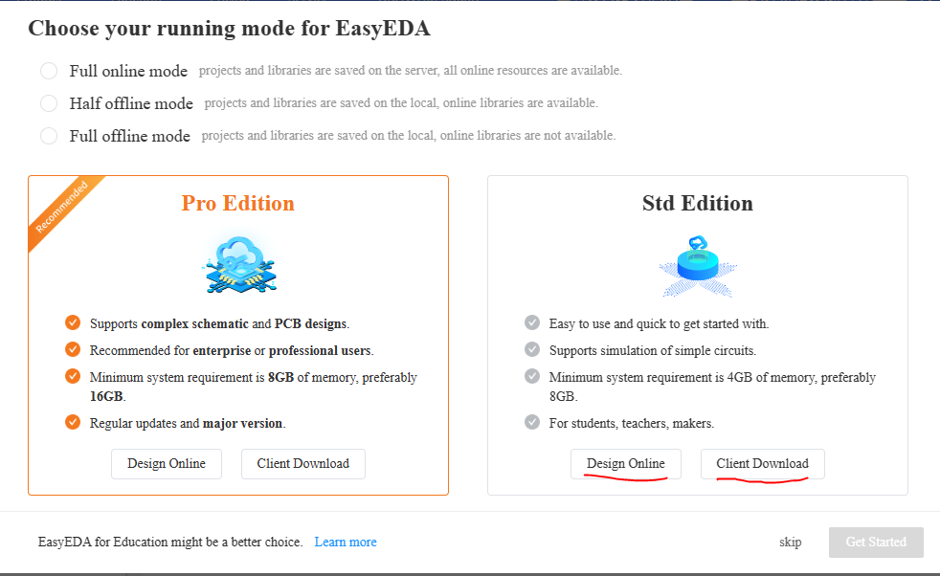
For any version, we select standard Edition

Slide 61
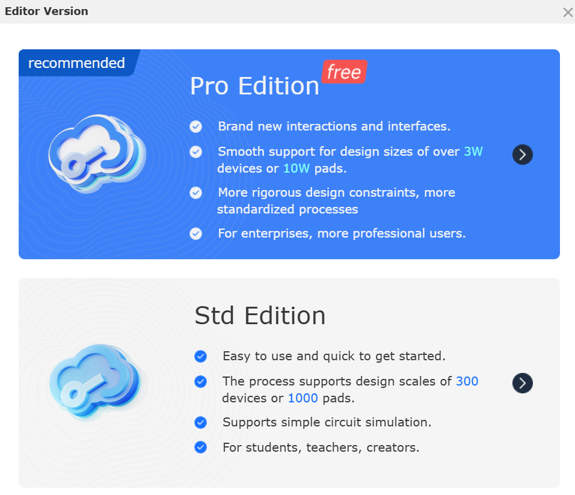
For any version, we select standard Edition

Slide 62
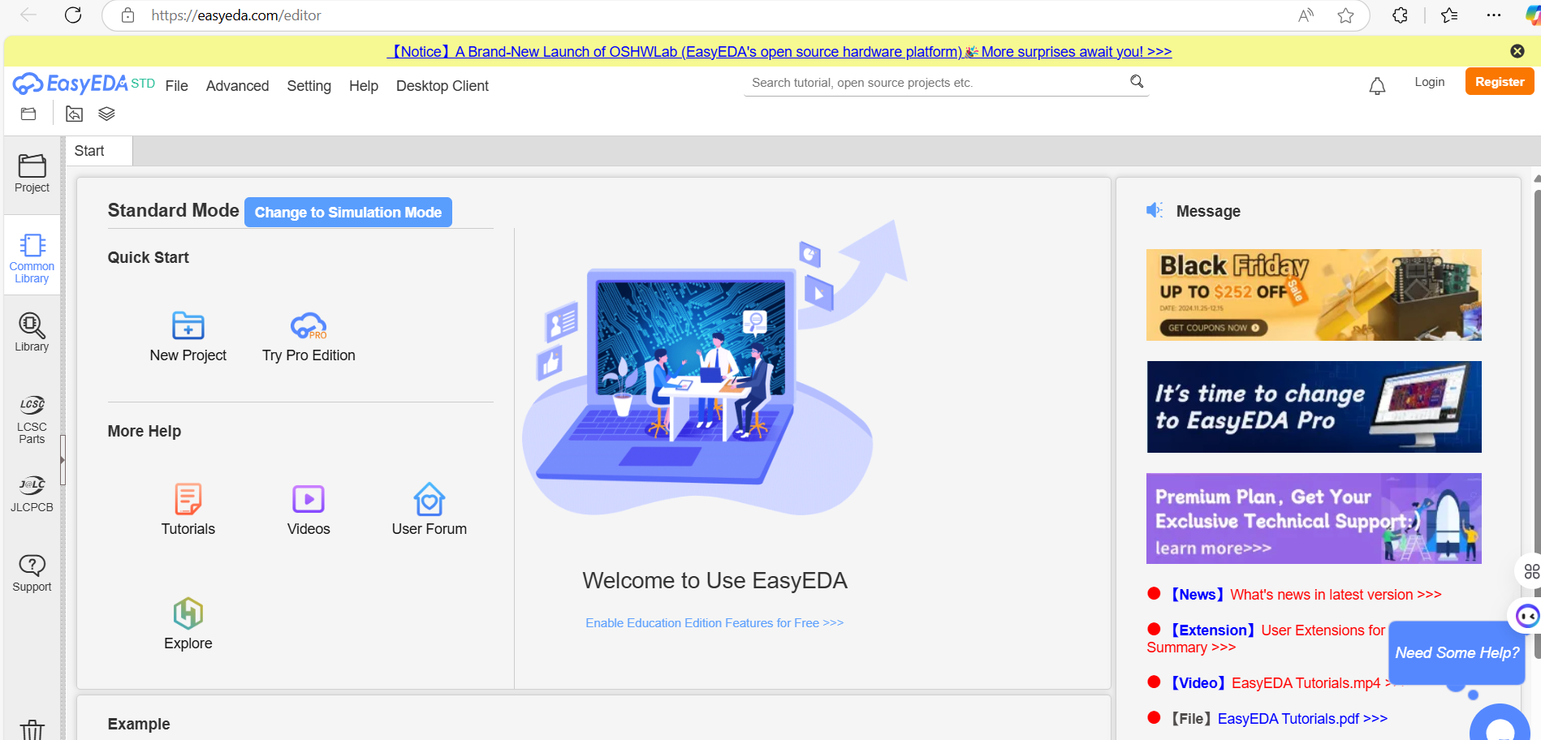
After clicking on the standard edition, you get interface below, and it very important to login before starting your project.

Slide 63
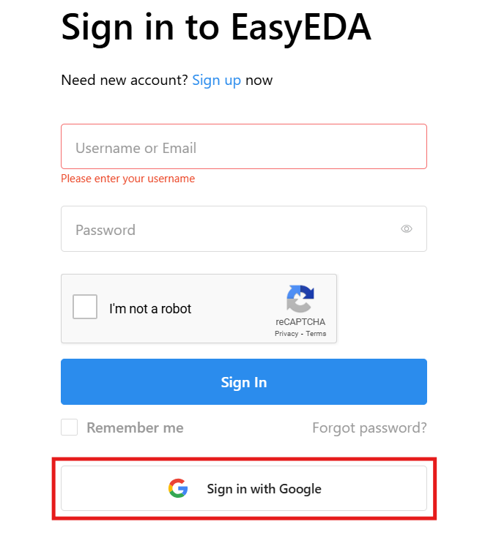
It is very important to sign in/login by using google account

Slide 64
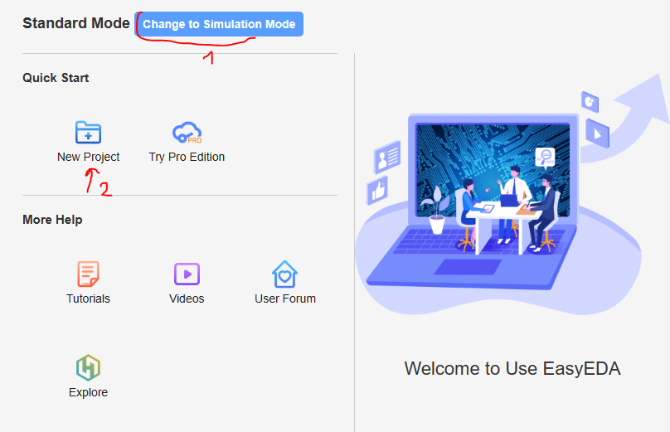

Slide 65
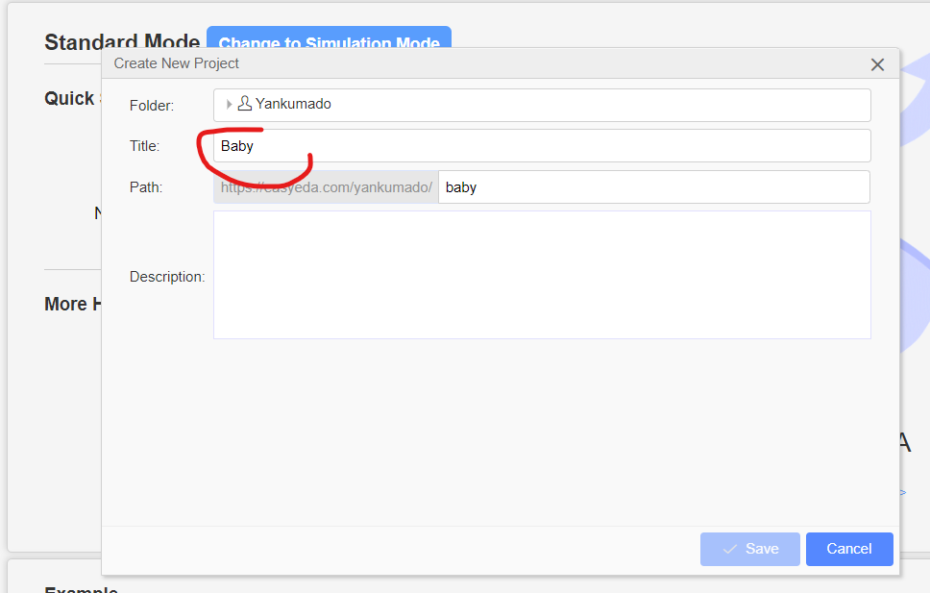
Rename your Project

Slide 66
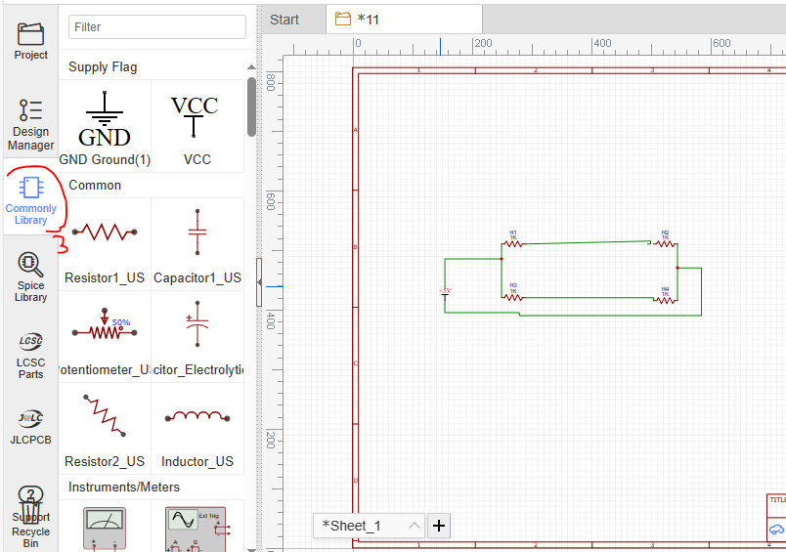
Then Click on commonly library and select component you need to use.

Slide 67
Conts…
Notice:
Once we create a free account and login we are ready to create our first project.
After we click the “new Schematics” button a blank work area will appear and we can start adding components.
The components are located on the left side of the screen and the EasyEDA library has most of the basic electronics components.

Slide 68
For Using the Interface:
Learn the keyboard shortcuts: This will significantly speed up your workflow (space bar to rotate, arrow buttons to move in any direction).
Utilize the online tutorials and documentation: EasyEDA provides extensive resources to help you get started.
Start with simple projects: Gradually increase the complexity of your designs as you gain experience.
Experiment and explore: Don't be afraid to try new things and see what you can create.
By following these steps and exploring the various features of the EasyEDA interface, you can effectively design and create your own PCBs.

Slide 69
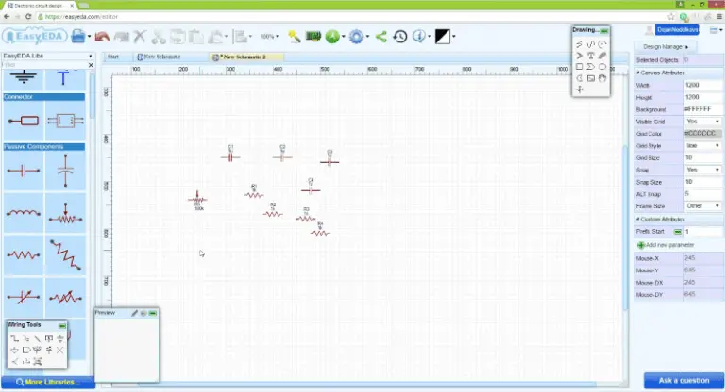
Continue, Select and point on and click on the stage to put on the components

Slide 70
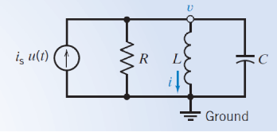
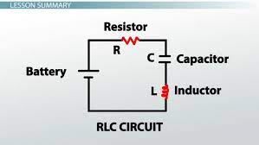
Exercises
Try to draw the following circuit diagram and try to provide their graphical simulation.
a) b)

Slide 71
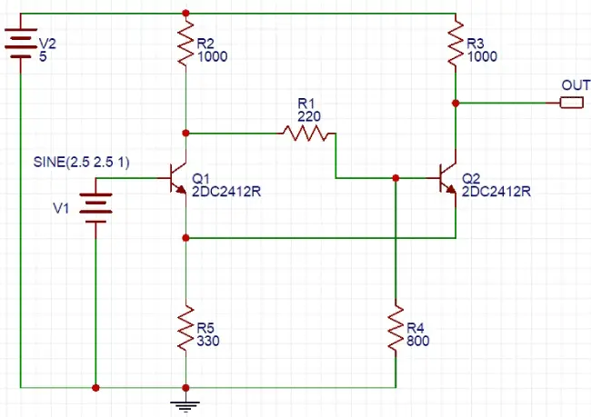
Conts,
c)

Slide 72
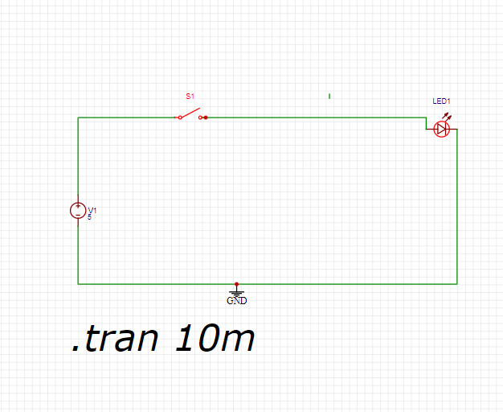
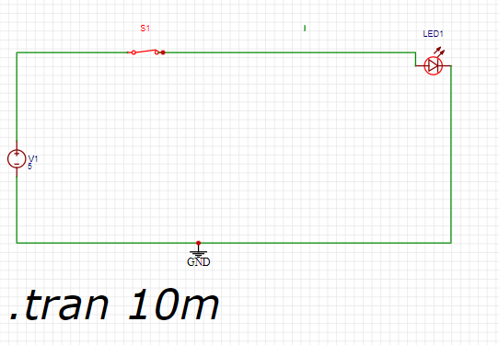
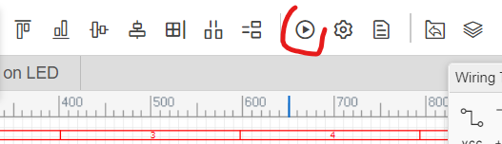
Simulation exercise(LED-switch-GND-DCV=5)
Open switch
Closed switch
Click on simulation tool

Slide 73
b)Fritzing
Design your own PCBs and have them fabricated from the files you design.
Fritzing is an open-source initiative to develop amateur or hobby CAD software for the design of electronics hardware, intended to allow designers and artists to build more permanent circuits from prototypes.
Fritzing is a great open-source tool for anyone to teach, share, and prototype their electronic projects. It allows you to design a schematic, and thus a part, which can then be added to very professional looking wiring diagrams. You can even design your own PCBs and have them fabricated from the files you design.
Fritzing comes with tons of electronic parts already installed with the software.
Before creating your own part, double check to see if it exists in those two locations or if another Fritzing user already made the part you need on the Fritzing forum. It will save you a lot of time if the part is already made.

Slide 74
DOWNLOAD AND INSTALL FRITZING
You will need to download and install the following software in order to follow along and make your own custom Fritzing part.
If you only need to make a basic IC, Fritzing (New) Parts Editor allows you to make custom ICs easily, and you won’t need to download a vector graphic editor. You can still follow along, since this tutorial will be building off a custom IC in the Fritzing (New) Parts Editor.
Go to the download page on the Fritzing site to download the latest Fritzing version for your OS. Find where you want to put the Fritzing application on your hard drive, and unzip the Fritzing folder in that location. The following are the links used to download fritzing software:
https://www.filecroco.com/download-fritzing/ for v0.9.3b
https://www.filehorse.com/download-fritzing-64/
https://github.com/TheChuckBerryPiProject/Fritzing/blob/main/fritzing-0.9.10-l1801-29c2cede-win64.msi

Slide 75
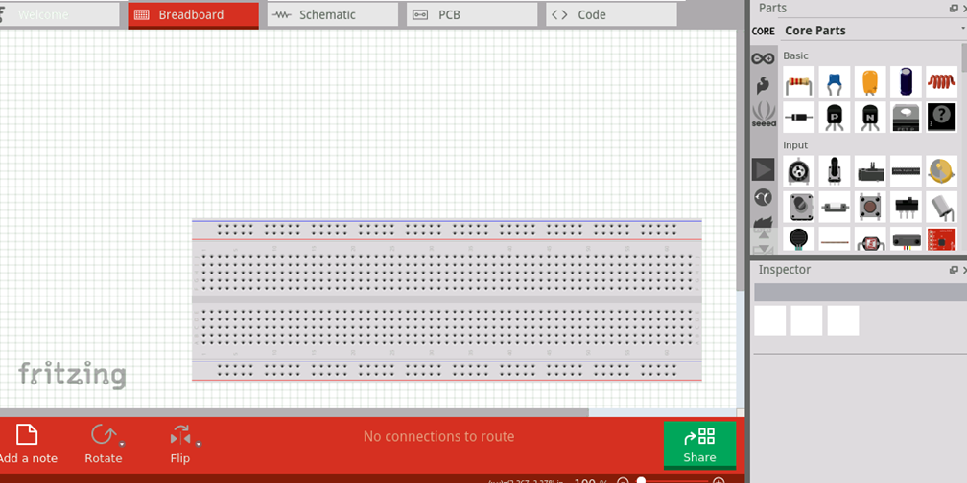
HOW DOES IT WORK AND HOW TO USE IT?
After login in the fritzing (existing user), you get Multiple Views/interfaces as: breadboard, schematic, PCB and code as menu:

Slide 76
Breadboard View: This view simulates a physical breadboard, allowing you to virtually place components and connect them with wires. It's ideal for prototyping and visualizing how a circuit would be built in real life.
Schematic View: This view provides a more abstract representation of the circuit, focusing on the logical connections between components. It's useful for understanding the overall functionality and sharing designs with others.
PCB View: This view allows you to design a printed circuit board (PCB) layout, including traces, pads, and component placements. It can be used to generate files for PCB fabrication.

Slide 77
How to Use Fritzing:
Download and Install: Obtain the latest version of Fritzing from the official website and install it on your computer.
Create a New Project: Start a new project and choose the desired view (breadboard, schematic, or PCB).
Add Components: Select components from the library and drag them onto the workspace.
Connect Components: Use the wiring tool to connect the components according to your circuit design.
Modify Components: Adjust component values, orientations, and other properties using the inspector panel.
Switch Views: Easily switch between the breadboard, schematic, and PCB views to visualize your circuit from different perspectives.
Simulate and Test: Use the simulation tools to check for basic circuit functionality.
Export and Share: Export your circuit design in various formats, including images, PDFs, and Gerber files for PCB fabrication

Slide 78
Fritzing and simulation by using breadboard
Components:
Make sure that the simulation is switched on
Battery Pack:
It's the power source for the circuit.
Typically, it consists of multiple AAA batteries (4)connected in series to provide a higher voltage (4.8v).
Resistor:
It's connected in series with the LED.
Limits the current flowing through the LED to prevent it from burning out.
The value of the resistor depends on the LED's forward voltage and the desired current.(100Ω)
LED (Light Emitting Diode):
It's the light source in the circuit.
It emits light when current flows through it in the forward direction (30mA).
Push Button:
It's a switch that completes or breaks the circuit when pressed.
When pressed, it allows current to flow through the LED, causing it to light up.

Slide 79
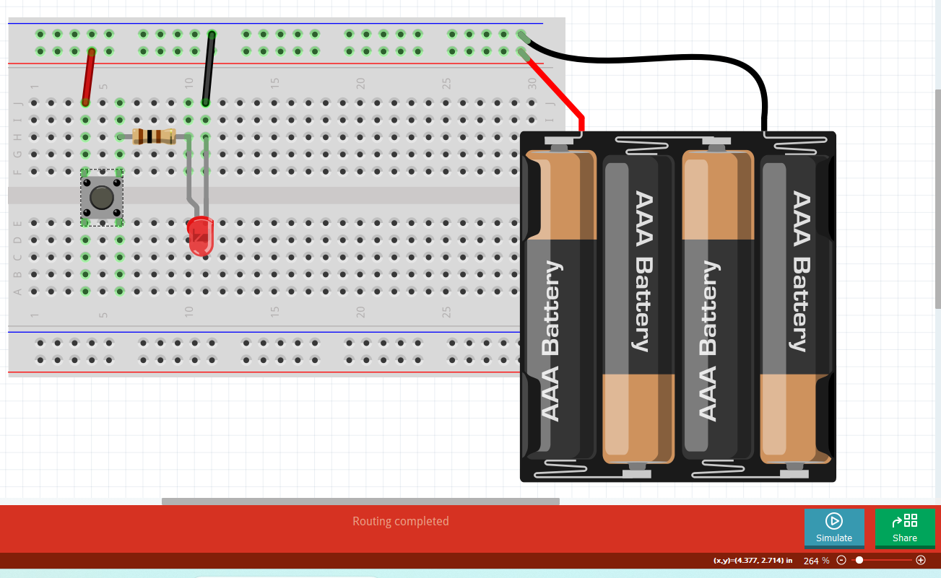
Fritzing and simulation by using breadboard
1
Interface after connecting components without simulation

Slide 80
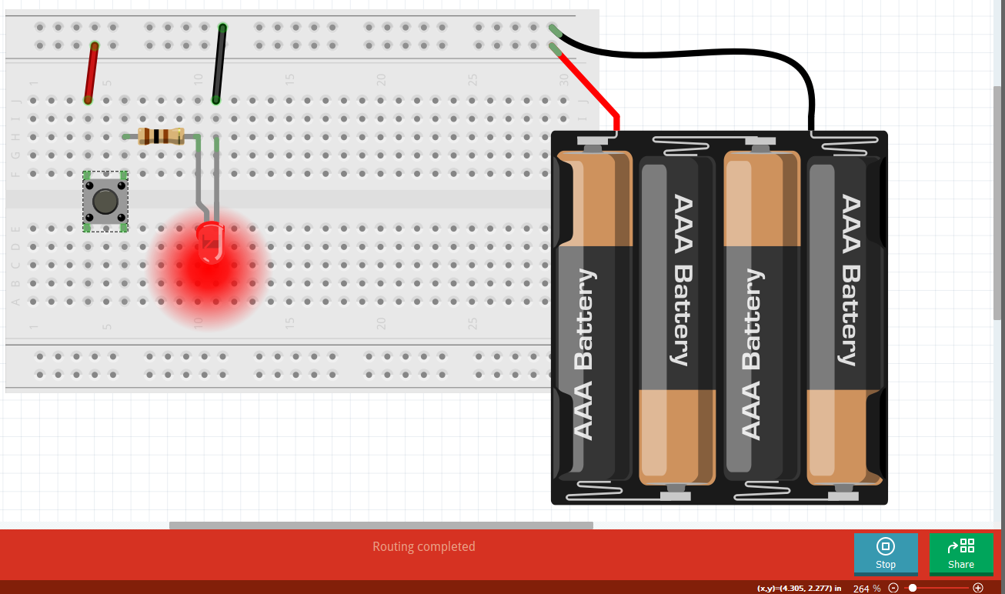
2
Make sure that you finish to click on simulation icon

Slide 81
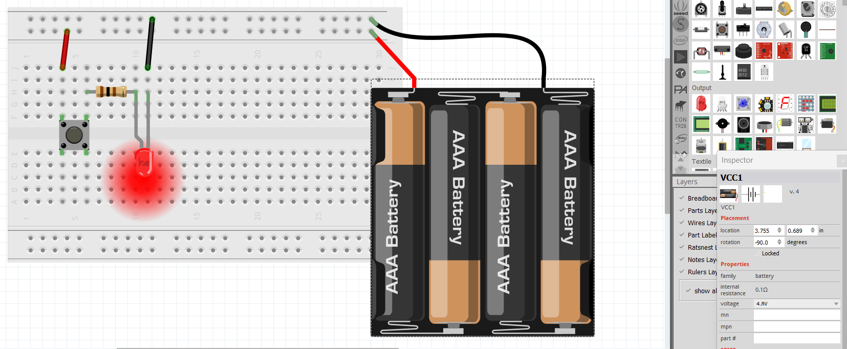
3
When you adjust battery value, LED can be destroyed (>>) or decreasing light(<<)

Slide 82
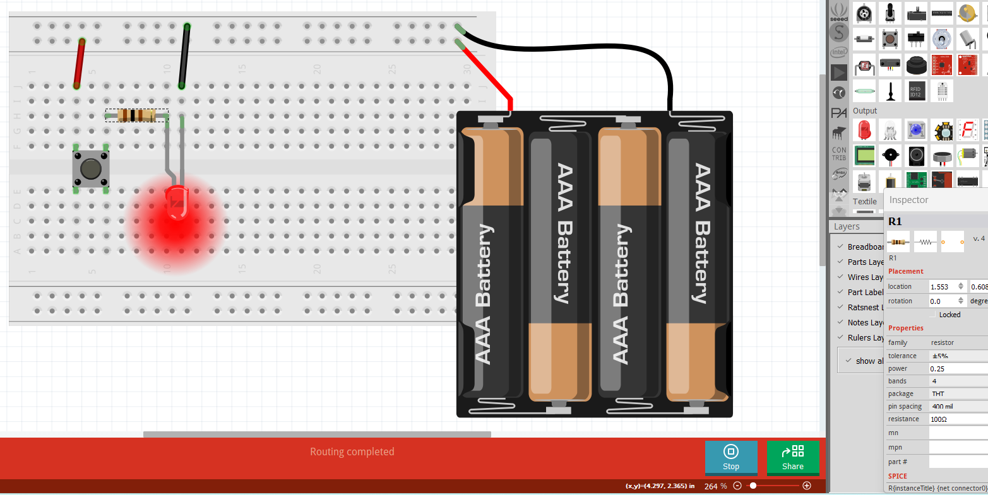
4
When you adjust resistance value, LED can be destroyed (<<) or decreasing light(>>)

Slide 83
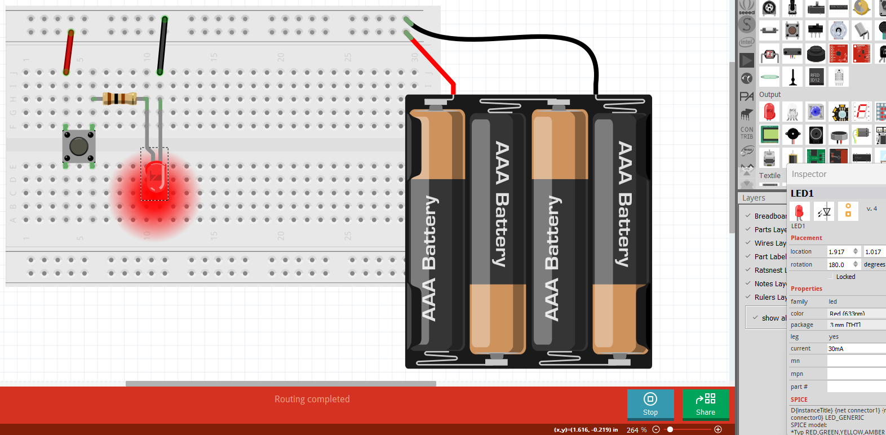
5
The value of current which passes thro the LED is not changeable.

Slide 84
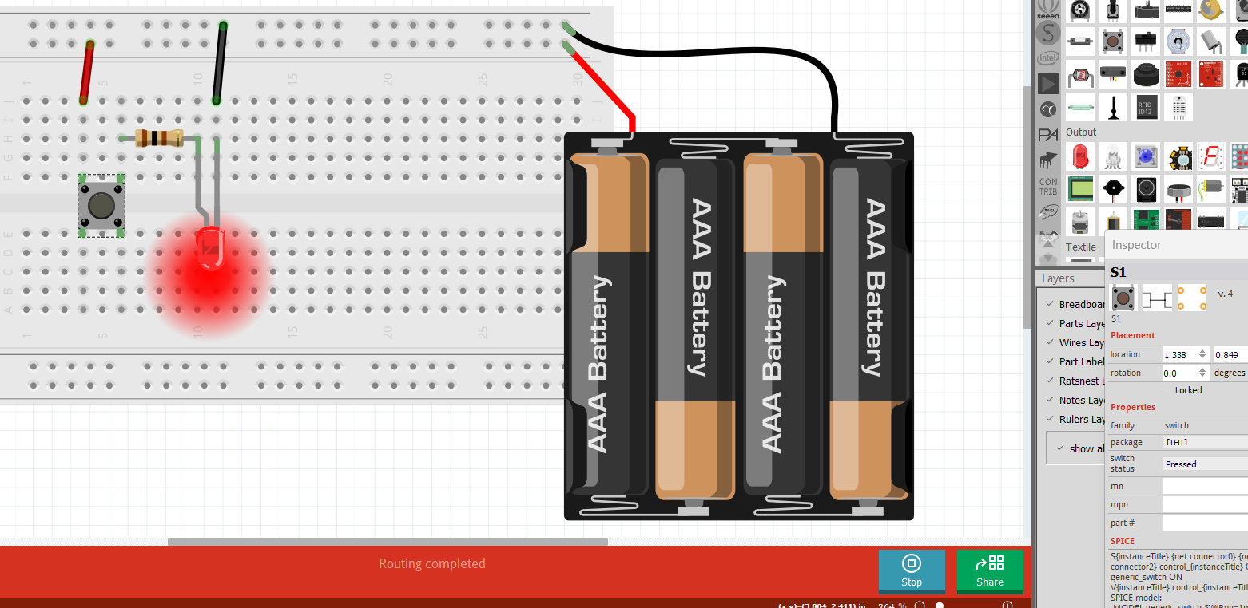
6
Make sure that your switch button is pressed elsewhere no light

Slide 85
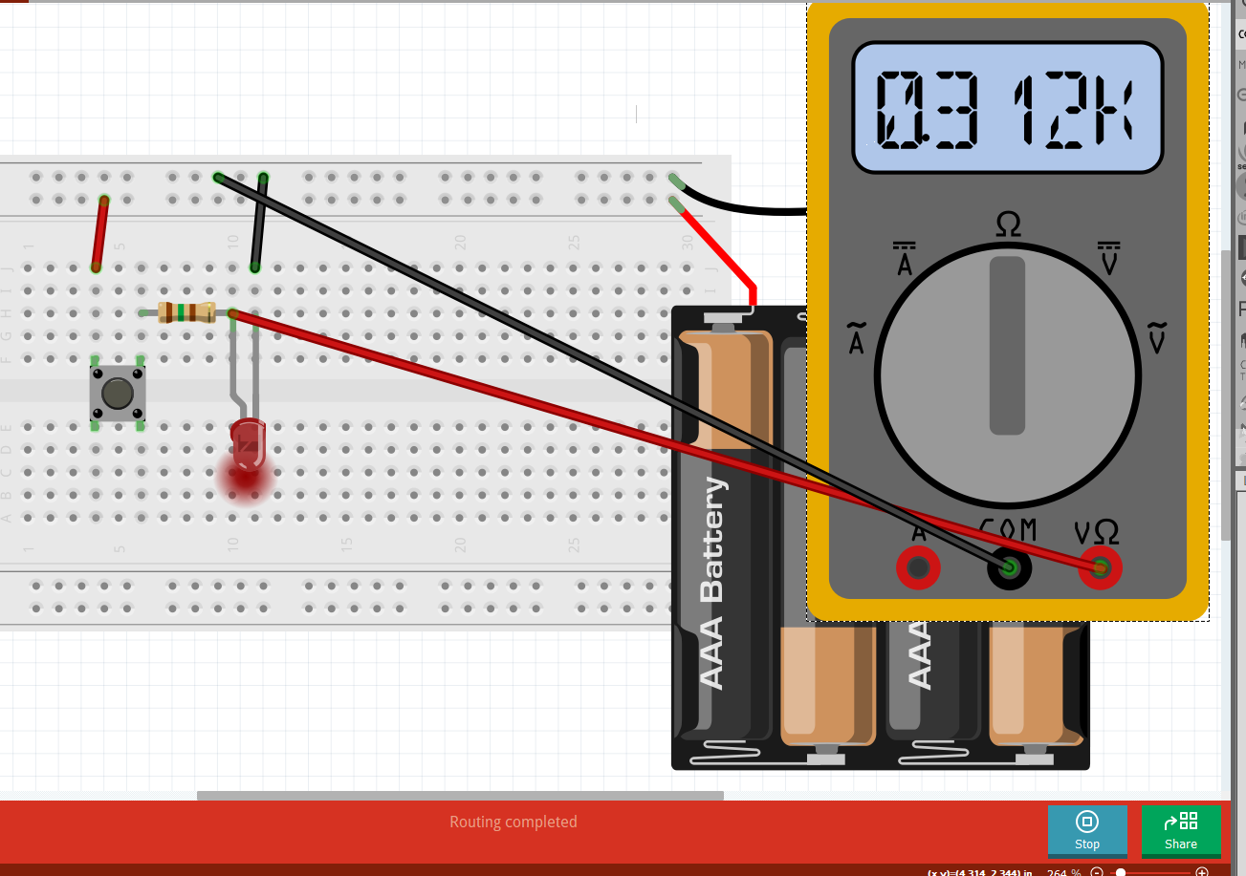
You can connect and apply different components and simulate them

Slide 86
Activities
Connect the 3 LED to 3 resistances with one switch on one battery and simulate your project.

Slide 87
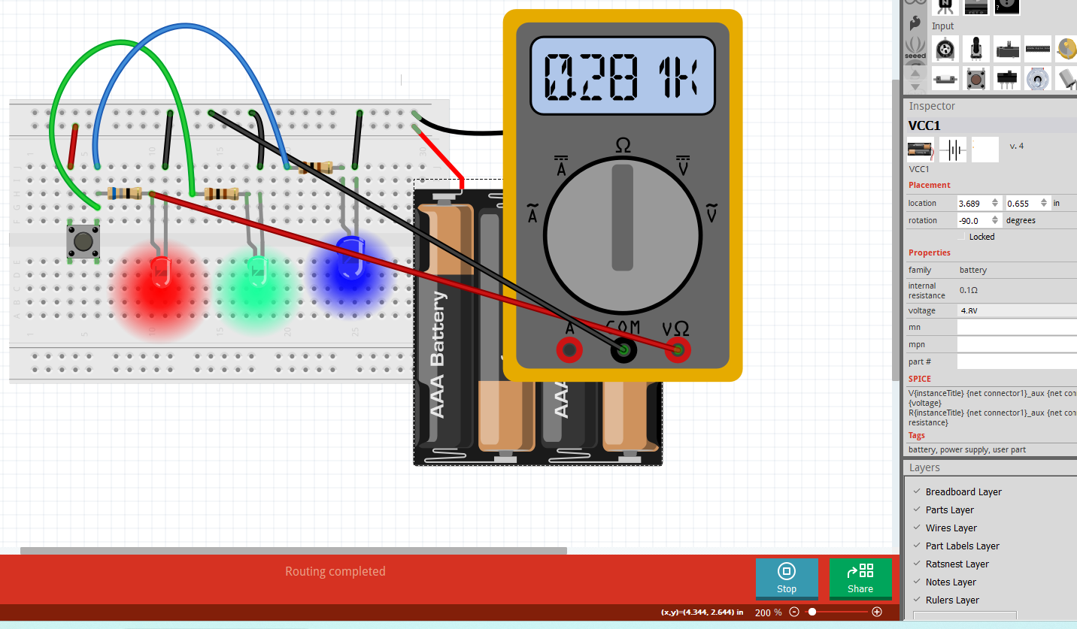
Answer

Slide 88
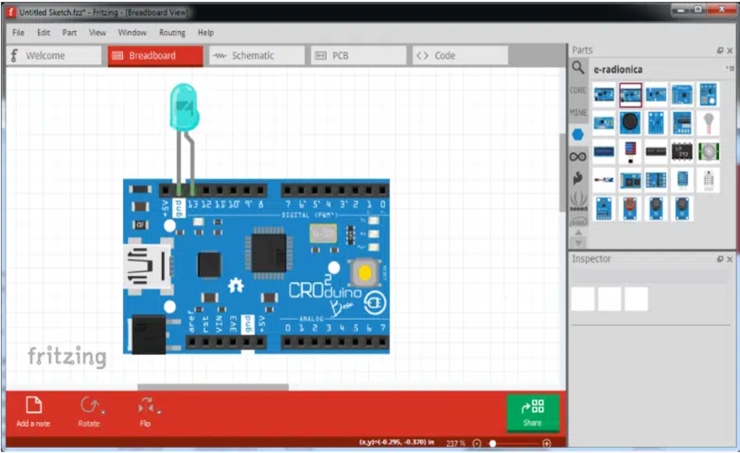
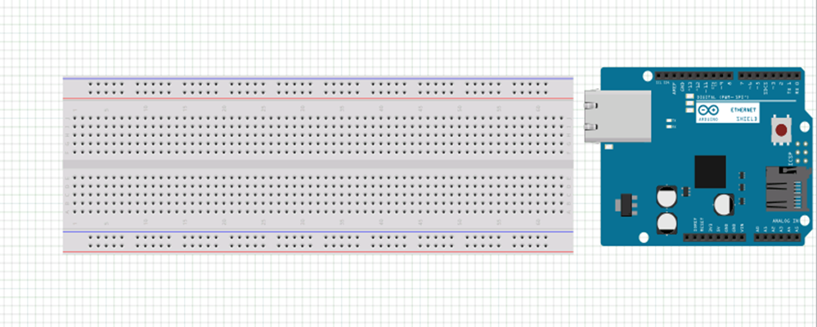
conts
You can connect different components on breadboard from right side in different tab like:
Led
Resistor
Arduino and connect together with wire

Slide 89
c)CircuitLab
CircuitLab provides online, in-browser tools for schematic capture and circuit simulation. These tools allow students, hobbyists, and professional engineers to design and analyze analog and digital systems before ever building a prototype. Online schematic capture lets hobbyists easily share and discuss their designs, while online circuit simulation allows for quick design iteration and accelerated learning about electronics.

Slide 90
DC Simulation with CircuitLab
Objectives: in this lab you will:
become familiar with the basic features and capabilities common to circuit simulation software
create and edit circuit schematics and simulations
perform DC bias point and DC sweep simulations
compute power from voltage and current measurement data
plot results
This lab introduces a surprisingly speedy and powerful way to determine the operating characteristics of a circuit using circuit simulation software tools. We will be using circuit simulations throughout this class to verify our understanding of circuit behavior and to demonstrate a different perspective on working with circuits. You can even use these tools to check the correctness of your homework solutions.

Slide 91
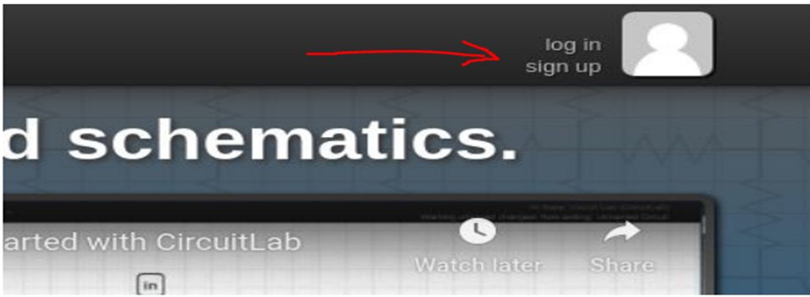
Before you start using CircuitLab
New Users, if you don't have a CircuitLab account simply create one by going to https://www.circuitlab.com/ and clicking the sign up link.

Slide 92
CONT’S
Once you sign up it will send you an email to verify your email address. You must click the link in the email sent you. If we are unable to verify your email your license will not activate. So, Visit this URL: https://www.circuitlab.com/accounts/eduverify/ to finish the site license activation process.
If you already have a CircuitLab account that uses your institution's email address there is no need to create a new account. Visit this URL: https://www.circuitlab.com/accounts/eduverify/ to activate the site license on your account.Once you have an account, you can save your circuits for later use. When you start up CircuitLab, the screen looks like the following:

Slide 93
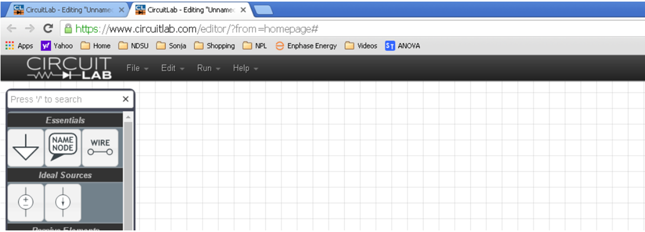

Slide 94
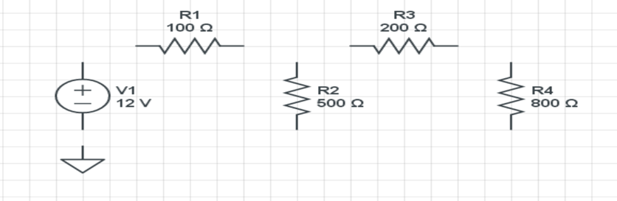
Build Mode
To build a circuit, drag and drop components from the left (we'll talk about what each one is later in this course)

Slide 95
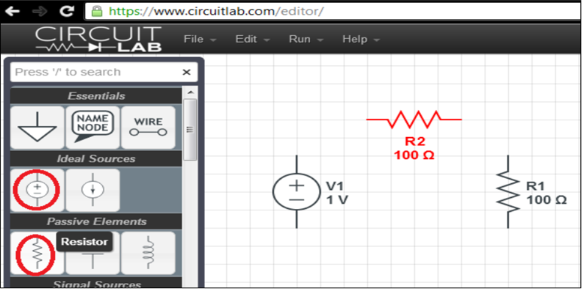
In build mode, you may simply drag components onto the canvas. We will need a DC voltage source and two resistors. Just click on the components in the left pane indicated by the red circle and drag the components into the workspace. To rotate a component, type the letter R after you begin dragging it or right click on the component then select rotate CW,or CCW. See figure below:

Slide 96
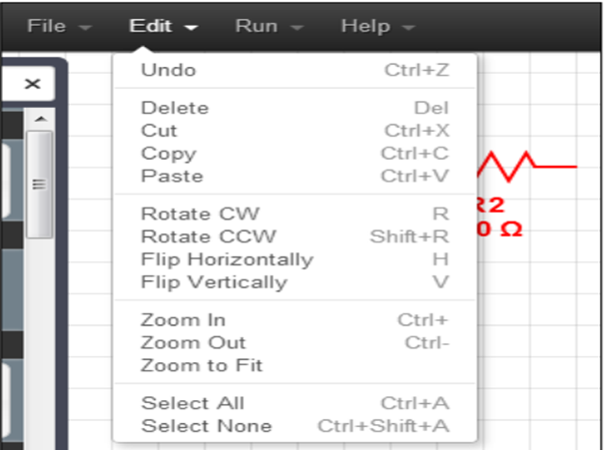
Other options for manipulating components are shown in the Edit menu, as illustrated in Figure below. You can rotate and flip, as well as cut, copy, delete, and paste each component, or groups of components in your circuit.

Slide 97
Connect wires: Once the components are laid out, we can connect them with wires. Click the wire symbol on the left (circled in figure below), then click the end of the first component you wish to connect, then drag to the end of the second component you wish to connect and let go the mouse button. You can also anchor a wire in the middle of the workspace the wire is drawn to wherever you release the mouse button.
Add a ground node: you must also add a ground node to your circuit. This is required for any circuit simulation you wish to perform. The ground symbol is circled in Figure below, which also shows the circuit fully wired and with ground added.(Ee, n.d.)

Slide 98
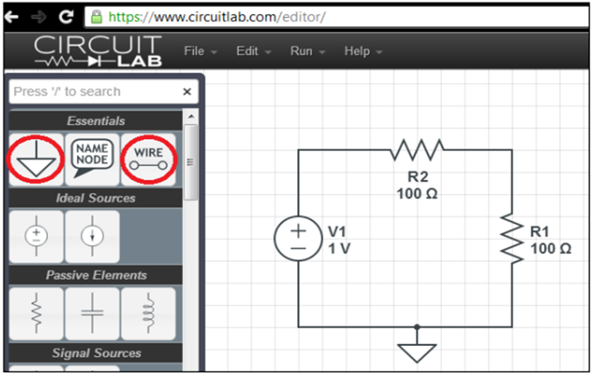

Slide 99
Change Component Attributes
We must change the settings on our components to match the name and values defined on the original problem Lab 4: DC Simulation with CircuitLab. Figure below shows the final circuit after setting the properties for the two resistors, with the dialogue for Rb still open. Note that we can change both the name and value of the components. This is important to realize. A common error is to accidentally change the name of a component to some numeric value, which will confuse the simulator.

Slide 100
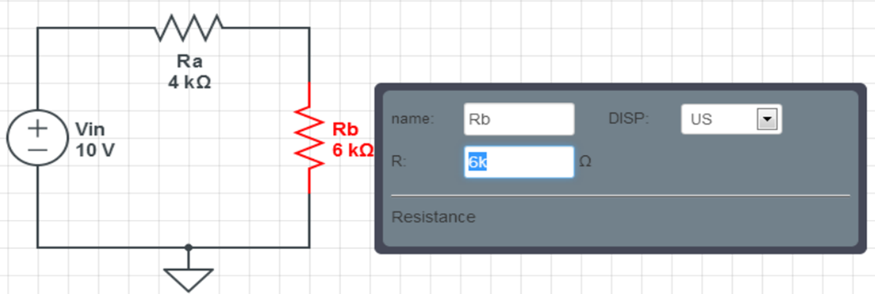

Slide 101
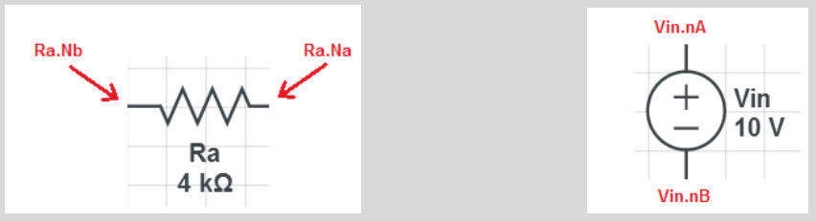
Default Node Labels. This is a good time to clarify the node labels for the components you have added to your circuit. Each component has an A node and a B node, labelled as Na or Nb after the name of the component. Depending on how you rotate the component, the A node can be above or left or below or to the right of the B node.(Users, n.d.)

Slide 102
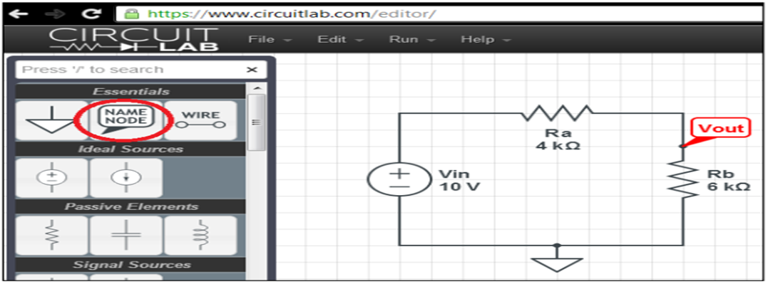
Add User Defined Node Labels: We can add our own node labels to identify any node voltages we wish to track with more meaningful names in the simulation results. Add a label for the Vout node as shown in figure below.

Slide 103
Move components: To move a component, simply click on it, then drag it to a new location. Note that the wire connection is broken when you move a component.
Move the entire circuit: Sometimes an entire circuit must be moved during the course of working with it. To move an entire circuit, first select the circuit by clicking and dragging a bounding rectangle around all of the components. Then click and drag the highlighted components to a new location. Once you’ve finished all steps, you are ready to switch to simulate mode.

Slide 104
Simulate Mode
In Simulate mode we set up the parameters for the type of simulation we wish to perform, and then we run the simulation. There are four types of simulation we can run:
DC,
DC Sweep,
Time Domain, and
Frequency Domain.
To switch to simulate mode click the Simulate button at the bottom left edge of the workspace; Run the DC Solver; Click on the DC Solver button. CircuitLab will indicate how long it takes to run the solver, but no information will be displayed on the circuit. However, when you move the cursor around to various points in the circuit, it changes into a “pen” which acts like a voltmeter/ammeter probe, reporting voltages and currents in the lower right hand corner.

Slide 105
Probe the circuit
Start by clicking on the Vout label we added to the circuit. This will add the variable V(Vout) the voltage at the Vout node to the list of circuit values to display. This is the voltage reading you would see with a voltmeter when the red lead is connected to the node, and the black lead is connected to ground. See the items circled in red in figure below.

Slide 106


Slide 107
Measuring current
To measure the current, I, asked for in the problem circuit of Figure, we can click on either the leftmost node of Ra (Ra.nB), or the topmost node of Rb (Rb.nA) as shown in figure below. These nodes will expand as large circles when your mouse hovers over them. Note that both of these nodes (Ra.nB and Rb.nA) are the point of entry for a clockwise current loop I flowing into each resistor (Ra and Rb). Therefore, a clockwise current flow would be considered positive at these measurement points in the circuit. That is why the current is listed as positive 1mA at these points. However, notice that I(Vin.nA) is negative on the readout inside the large red oval in figure below. This is because our clockwise current is leaving the voltage source at that node.

Slide 108


Slide 109
Conclusion:
When you probe a circuit in Simulate mode, the current flowing into the component attached to the node you click is what you will see displayed on the left, with a sign that indicates positive for current flowing into the component and negative for current flowing out of the component at the node you clicked on.

Slide 110
Adding expressions
Suppose you wish to know the voltage across the Ra resistor. Since all our voltages calculated by DC Solver are relative to the ground node, you can click the “+Add Expression” button to add a math expression to find this voltage. According to KVL, the voltage across Ra would be V(Ra.nB) – V(Ra.nA). Add this expression to the list of values as shown in figure below. To compute the power dissipated by the Rb resistor, also add the expression V(Rb.nA)*I(Rb.nA). That’s the voltage across Rb times the current going through it. If you see N/A you may need to click Run DC Solver again.

Slide 111


Slide 112
Using a Voltmeter and Ammeter to measure circuit variables
Another way to measure circuit variables is to insert virtual volt and current metering elements into your circuit. To do this, first switch back to Build mode by clicking the large button at the bottom left edge of the screen. Next, scroll down the component gallery to find the “Unsorted Elements” section and locate the Voltmeter element. Drag it into your circuit alongside Rb and wire it in so it has a parallel connection with Rb. For the ammeter, you will need to delete a wire to make room for the series connection, and you may also need to slide Ra to the right, as shown in figure below.

Slide 113


Slide 114

To show the readout of these meters on the schematic, you have to double click on the component and check the Show-Current or Show-Volt box indicated in Figure below.

Slide 115

Add an additional voltmeter to measure the volts across Ra. You may need to move your circuit around to make it fit in the workspace. Take a screen capture of your final simulation for your report. Instructions on how to take a screen capture are here: (PC) (Mac)

Slide 116

SOME EXAMPLES

Slide 117

OUTPUT

Slide 118

EX2

Slide 119

OUTPUT

Slide 120
DESIGN YOUR CIRCUIT WITH CIRCUITLAB

Slide 121
Offline Tools
a) Proteus
b) Altium Designer
c) KiCAD
d) EagleCAD
Offline tools like Proteus, Altium Designer, and KiCAD are commonly used in the field of electronics design and printed circuit board (PCB) development. They help engineers and designers create schematics, design PCB layouts, and simulate electronic circuits. Here's an overview of each tool and how they work:

Slide 122
Proteus
Proteus is a comprehensive software suite for electronic design and simulation. It consists of two main components: ISIS (Intelligent Schematic Input System) for schematic capture and ARES (Advanced Routing and Editing Software) for PCB layout. Here's how it works:
Schematic Design: In ISIS, you can create electronic schematics by placing components like resistors, capacitors, ICs, etc., and connecting them with wires. Proteus provides a vast library of pre- modeled components for easy integration.
Simulation: One of Proteus's significant features is the ability to simulate your electronic circuits. You can add virtual instruments and run transient, AC, and DC simulations to verify the behavior of your circuit.

Slide 123
PCB Layout: After designing your schematic, you can transfer it to ARES for PCB layout. ARES provides tools for placing components on the PCB, routing traces, and generating the necessary manufacturing files.
3D Visualization: Proteus also offers 3D visualization, which allows you to see a realistic representation of your PCB, helping you detect and fix potential issues.
Integration: Proteus offers a seamless workflow, where changes made in the schematic are automatically reflected in the PCB layout, ensuring consistency in the design.

Slide 124
Let us start to download and install Proteus 8.xx
Proteus Professional 8.6 Free Download (freesoftwarefiles.com)

Slide 125
Getting Started With Proteus 8
In this guide, the basics of Schematic Capture in Proteus Design Suite will be covered step by step. After reading, the student should be familiar with the Proteus interface and be capable of constructing different digital circuits. This document is not a thorough guide to Proteus, it is meant to cover Proteus use cases for EE346 Microcontrollers Lab only and will not cover PCB layout, Visual Design, and other modules of the software as they are not needed in the Microcontrollers course. Proteus is a powerful tool that all EE students should explore. Proteus 8.9 Professional will be used to demonstrate the steps; however, steps should also apply to other versions of Proteus 8.

Slide 126

Creating a File
After installing Proteus and activating your license, you will be met with a page similar to that shown below:

Slide 127
Characteristics view of proteus
Getting Started & Help: Some useful guides can be found here; it is advised to avoid them.
Start and Recent Projects: Here you will find the projects that you opened last. This section will be empty if you just installed Proteus.
News: This section will contain news about your current license, recent versions of the software, and links to basic video tutorials that you might find helpful.

Slide 128
To create a new project, follow the steps below:

Slide 129

1. Click on New Project under the Start header in the home page:

Slide 130

2. The New Project Wizard window will now open. Choose a name and file-path for your project:

Slide 131

3. Unless certain dimensions are required (for printing or otherwise), DEFAULT will suffice.

Slide 132

4. Select Do not create a PCB layout and click Next, Select Firmware:

Slide 133

5. Select No Firmware Project and click Next

Slide 134

6. You should now see a summary of all your previous selections. If any mistakes were made, you can click Back and correct them.
Click Finish to open the Schematic Capture module and begin working on your project.

Slide 135

Interface of new project
Notice: Creating a new project can be done by clicking Ctrl+N or from the File menu in the menu bar, then follow steps 2 through 6
Notes:
Notice: Creating a new project can be done by clicking Ctrl+N or from the File menu in the menu bar, then follow steps 2 through 6

Slide 136
The Schematic Capture interface is split into four main parts:
The Menu or Module bars on top,
The Sidebar on the left-hand side,
The Root sheet in the center, and
The Simulation Control bar at the bottom

Slide 137

1.Module Bar

Slide 138

2.Sidebar:

Slide 139

Collecting Parts
In this part, we will prepare all the parts needed for our experiment.
Open the Part Picker (S12 or M14):

Slide 140

After the “Pick Devices” window has appeared, begin writing keywords for the part you are looking for then Click OK to add the part to your list of components

Slide 141

When components are not available in parts picker/No Libraries Found (Proteus Error)

Slide 142


1. Now one last step, move to the desktop and right-click on Proteus icon, and click on properties
2. Now click on Compatibility and mark the changes below

Slide 143
ACTIVITIES-PRCTICE

Slide 144


LOGICAL FUNCTION INPUT AND OUTPUT TOOLS
INPUT
OUTPUT

Slide 145




2. LOGIC GATE WITH INPUT AND OUTPUT

Slide 146
1.INSERT SOME LOGICAL GATES

Slide 147

ACTIVITY3: LOGICAL FUNCTION COMBINATION AND ITS INPUT

Slide 148

ACTIVITY3: LOGICAL FUNCTION COMBINATION AND ITS OUTPUT

Slide 149
SELF ACTIVITY1
TRY TO GET LOGICAL OUTPUT BY USING
OR GATE
NOR GATE
NAND GATE
XOR GATE

Slide 150

SELF ACTIVITY2(SHORT QUIZ/10)
TRY TO GET LOGICAL OUTPUT BY USING THE FOLLOWING DESIGN IN PROTEUS

Slide 151
Proteus is used in different activities with different components. So now let us use it to display:
LED ON and OFF
Traffic light with Arduino IDE
Tasks
Insert the components (LED, and ARDUINO and sometimes Resistance) in proteus sheet,
Connect the components
Coding in Arduino and link them into proteus
Make sure you have Arduino library in proteus
Make sure your code is saved in compilation feature in local disk C

Slide 152

Insert the components
Using parts picker (P) to upload components in schematic capturing area

Slide 153

In number select a component then double click on it to include it on the part picker space and call Arduino with the same way used above.
In the part picker, select a component and click double click on the schematic capturing sheet to fix that component, do it more than one depending on the number of components you want to include in your design.

Slide 154
Arduino Code used
int led=13;
void setup() {
// put your setup code here, to run once:
pinMode(led,OUTPUT);
}
void loop() {
// put your main code here, to run repeatedly:
digitalWrite(led,HIGH);
delay(1000);
digitalWrite(led,LOW);
delay(1000);
}
Then compile Arduino code

Slide 155

Cont’s

Slide 156


Copy the link from compiling and paste into program file and click on ok

Slide 157


Before displaying After displaying
Click on display button

Slide 158
Traffic light
With traffic light, we do the same activity only the change of number of LED (RED, YELLOW and GREEN) and codes. You insert the components in part picker, then select one by one to include into schematic capturing and connect them, go to Arduino uno to code and compile, copy the link and paste into program file in Arduino uno editor and click on display to get the result.

Slide 159


Name of Components in the part picker and viewing of components in schematic capturing area (Arduino uno, LED[RED,YELLOW and GREEN],ground)
Adruino code

Slide 160
Adruino uno code for traffic light
// Traffic Light Pins
const int redPin = 13;
const int yellowPin = 12;
const int greenPin = 11;
// Delay durations in milliseconds
const int redDuration = 1000; // 2 seconds for red
const int yellowDuration = 1000; // 2 seconds for yellow
const int greenDuration = 1000; // 2 seconds for green
void setup() {
pinMode(redPin, OUTPUT);
pinMode(yellowPin, OUTPUT);
pinMode(greenPin, OUTPUT);
}
void loop() {
// Red light
digitalWrite(redPin, HIGH);
delay(redDuration);
digitalWrite(redPin, LOW);
// Yellow light
digitalWrite(yellowPin, HIGH);
delay(yellowDuration);
digitalWrite(yellowPin, LOW);
// Green light
digitalWrite(greenPin, HIGH);
delay(greenDuration);
digitalWrite(greenPin, LOW);
}

Slide 161


Output after coding, copying link, paste and closed into program file of proteus and clicking on display button

Slide 162
Notice: if the proteus has not Arduino library, do the following steps:
Download the Arduino uno library from this link: Arduino Library.rar - Google Drive
Extract Arduino file and open and copy two files are founding in extracted file (rar)
Go to local disk C, open it =>go to program file(x86)=> labcenter electronics=>proteus 8 professional=>library =.paste the copied files from Arduino library=>close

Slide 163
Practice-design /simulation application by using PROTEUS

Slide 164

1. First Electronics Project in Proteus ISIS

Slide 165
2. Designing of 38 kHz frequency generator by using 555 timer IC

Slide 166

3. Proteus circuit model for the regulated power supply system

Slide 167

Simulate the IR (Infrared) Sensor with Arduino in Proteus

Slide 168
int IRSensor = 8; // connect ir sensor to arduino pin 2
int LED = 11; // connect Led to arduino pin 13
void setup()
{
pinMode (IRSensor, INPUT); // sensor pin INPUT
pinMode (LED, OUTPUT); // Led pin OUTPUT
Serial.begin(9600);
delay(500);
Serial.println("Welcome to Microdigisoftn");
}
void loop()
{
delay(500);
Serial.print("IR Sensor value= ");
Serial.println(digitalRead(IRSensor));
int statusSensor = digitalRead (IRSensor);
if
(statusSensor == 1)
digitalWrite(LED, LOW); // LED LOW
else
{
digitalWrite(LED, HIGH); // LED High
}
}

Slide 169
2. Altium Designer
Altium Designer is a popular Electronic Design Automation (EDA) tool for PCB design.It is a software integration platform that brings together all the tools necessary to create a complete environment for electronic product development, in a single application.
It combines:
Schematic capture
PCB layout, and
Comprehensive project management

Slide 170
Obtaining the Offline Installation Package
This is a zipped collection of the necessary installable (including extensions), along with the relevant Altium Designer Installer.
The Offline Installer can be obtained directly from the Altium Designer section of the Altium website's Downloads page by clicking the Need Offline Installer? link.

Slide 171

You must be signed into Altium Live.
A pop-up window will appear prompting you to enter a reason why you need an Offline Installer.
After entering your reason, click the Submit button.

Slide 172

A second pop-up window will confirm that your request has been received.

Slide 173

Once you receive the confirmation email, go back to the Downloads page, the link will have been replaced with a button with which you can download the installer.
You may need to sign out of AltiumLive and then sign back in again to see the button.
Once the initial request has been approved, you will always be able to have access to the corresponding Offline Installer for each existing version of the software, as well as new versions as they are released. Just select the version of Altium Designer required, and the button will update accordingly.

Slide 174

Running the Installer
Browse to the location on your hard disk into which you have unzipped the offline installation package and double click the Installer.exe file. The Altium Designer Installer welcome page will open.
Initial welcome page for the Altium Designer Installer. Click Next to continue.

Slide 175

License Agreement
This page of the Installer presents you with the Altium End-User License Agreement (EULA).
Read and accept Altium's End User License Agreement.
After reading the EULA, continue with the installation by checking the I accept the agreement box and clicking the Next button

Slide 176

Installation Mode
If you have an existing installation of Altium Designer, and that installation can be updated to the new version you are trying to install now, this page of the Altium Designer Installer wizard will be available.
Install a new instance of Altium Designer, or update an existing instance.

Slide 177
The above page gives you the choice between:
Installing a separate new instance of Altium Designer – use this option the first time you install Altium Designer with the Offline Installer.
Updating an existing installation of Altium Designer – use this option when you are updating your offline installation of Altium Designer. If you are updating an existing installation, you can select the product instance being updated.
Select the required installation mode, and click Next to continue.

Slide 178

Select Design Functionality
This next page of the Installer allows you to specify which features are installed initially. The PCB Design option provides the base software and core technologies required to perform PCB design. It is always installed and cannot be deselected. Use the remaining options to tailor the install to suit your needs.
After defining what functionality you would like, click Next to proceed.

Slide 179

Destination Folders
This next page of the Installer allows you to specify the destination folders for the install, in terms of both the Program Files for the software and the Shared Documents that are accessed and used by the software.

Slide 180
Program Files
C:\Program Files\Altium\AD22
Shared Documents
C:\Users\Public\Documents\Altium\AD22
To specify alternate locations, type the location directly into the applicable field or click the folder icon at the right of a field and browse for the required destination folder. Once the install locations are specified, click Next to continue.

Slide 181

Customer Experience Improvement Program
This page is used to choose whether to participate in the Customer Experience Improvement Program. Since this program requires connection with Altium, it is not required for an offline installation, therefore, you can choose the Don't participate option then click Next.

Slide 182

Ready To Install
The Installer now has all the information it requires to proceed with the installation. If you need to change anything, click the Back button. If you want to cancel out of the install, click Cancel.
Ready to begin the install!
To proceed with the installation, click Next

Slide 183

Installing Altium Designer
The page will change from Ready to Install to Installing Altium Designer and the installation will proceed with the required files first being prepared (from the set of files contained within the unzipped Offline Installation package). Progress of this preparation is displayed within the Installer itself.

Slide 184

Once the preparation of files is complete, they will be installed, again with progress displayed in the Installer.

Slide 185

Installation Complete
When the installation itself completes, you have reached the end of the Installer wizard.
Click Finish to exit the wizard

Slide 186

Importing Preferences from a Previous Version or Major Release
After installing and launching your new version of Altium Designer, the Import settings dialog will open in which you are given the opportunity to import preferences from the most recent previous installation at startup.

Slide 187

Licensing the Software
When Altium Designer starts, it will display the License Management page, as shown in .the image below:

Slide 188
There are now two actions to perform in order to setup the software to work effectively offline:
Configure Altium Designer to operate in an offline mode so that it will not attempt to contact Altium to validate licensing.
Add a standalone license file, which is required to unlock Altium Designer's functionality.

Slide 189
Switching to Offline Mode
To switch Altium Designer to an offline mode, essentially severing the connection to Altium:
Click on the Account preferences link. This gives access to the System Account Management page of the Preferences dialog.
Enable the No, I wish to remain disconnected from Altium option. By enabling this option, your installation of Altium Designer will stay completely disconnected from Altium. While disconnected, you will not be able to access or use any of the on demand services that require a connection with Altium. In essence, this option is a 'full offline' switch.
Click OK to accept the change and close the Preferences dialog.

Slide 190


Slide 191

In addition, confirmation that you are using an offline installation of the software can be seen on the System Installation page of the Preferences dialog. The Offline installation option will be enabled with the path to the unzipped offline installation package folder.
Note that the offline installation does not check for updates or new extensions regardless of the status of the Altium Connection setting. To perform an update you will need a later copy of the Offline Installation package.

Slide 192
Adding the License File
First, you need to procure the required Standalone license file. This can be downloaded by signing in to the AltiumLive community area of the Altium website, opening the Dashboard (selecting the Company Dashboard from the menu of your photo/picture at the top right of the page) then going to the Licenses section. When you click on a license to examine the details, there is an Activate button. Click this to download the licensing file (*.alf) for that license.

Slide 193
With the Standalone license file acquired, you can now proceed to use that file to license your offline instance of Altium Designer. To do so:
On the License Management page (within Altium Designer), click the Add standalone license file link.
The Open dialog will open in which you can browse to and select the license file you just acquired.

Slide 194


Slide 195

Once you have selected the license file and returned to Altium Designer, the License Management page will display the license details, as shown below.

Slide 196

An offline installation can also be licensed using the Private License Service available as part of an Altium On-Prem Enterprise Server or Altium Infrastructure Server.

Slide 197


Slide 198


Slide 199


Slide 200
END

